Slide 1
Home Automation Using Arduino
ASAD FAROOQ (01-134202-119)
HAMZA GHAFRAN (01-134202-122)

Slide 2
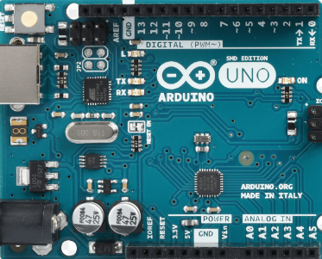
ARDUINO
Microcontroller for Projects
Simplified Programming
Smart Devices with Arduino
Revolutionizing Home Automation
Connecting the Physical and Digital Worlds

Slide 3
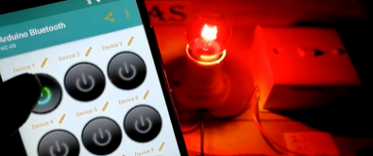
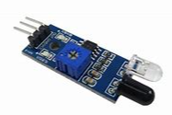

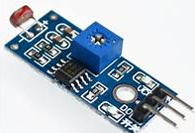
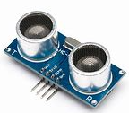
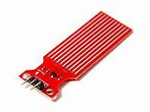
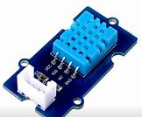
Functionalities
Lighting Control
Temperature and Climate Control
Security Systems
Control through smart phone
Smart Door & Locks
Water pump auto on/off

Slide 4
Objective
Convenience
Energy efficiency
Remote access and control.
Ensuring security

Slide 5


Methodology
Arduino microcontrollers to connect and control devices
sensors to gather data for intelligent decision
Respond to user preferences
Environmental conditions
Security requirements
User-friendly interface
Smartphone integration
Extensive testing

Slide 6

Home Automation
Sensor Integration
Energy Efficiency
Security and Surveillance
User Interface and Control

Slide 7

Feasibility
Study
RISKS:
RECUIREMENTS
Technical Challenges
Compatibility Issues
Security Vulnerabilities
Reliability and Robustness
Hardware
Softwares
Computing Resources
Connectivity

Slide 8

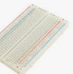
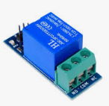
Tools &
Technology
Hardware Tools
Software Tools
Sensors
Actuators
Communication Modules
Power Supply
Breadboard or PCB
Wiring and Connectors
Arduino IDE
Libraries
Programming Languages
Power Supply
Simulation Tools
Data Analysis and Visualization Tools

Slide 9
Application Areas
Areas
Benefits
Residential Homes
Energy Management
Security and Surveillance
Environmental Monitoring
convenience and comfort
energy efficiency and reduced utility bills
Enhanced security
Environmentally friendly practices and resource optimization

Slide 10


Review &
Research Gap
Studies on:
GAP:
Smart home technologies
Automation systems
Arduino-based projects
home automation
user preferences
Limited studies
Scalability issues
Interoperability concerns
Affordability concerns
Practical implementation challenges
gaps in privacy,security concerns.

Slide 11

Milestones
1. Research and Planning
2. Hardware Setup
3. Sensor Integration
4. Actuator Integration
5. Communication and Networking
6. Data Processing and Analysis
7. User Interface and Control
8. Testing and Debugging
9. Documentation and Presentation

Slide 12

Limitations
Technical limitations
Time limitations
Resource limitation
Skill limitations
Scope limitations
Environmental limitations
Scalability limitations

Slide 13

Future
Expansion
Integration with Internet of Things
Incorporation of machine learning algorithms
Integration with voice assistant
Advanced security features
Exploration of advanced sensing technologies
Facial recognition or biometric authentication.
Use of raspberry pi.

Slide 14

Team Expertise
ASAD FAROOQ(01-134202-119):
Works on Hardware
Check the code compatibility with sensors and other components.
HAMZA GHAFRAN(01-134202-122):
Works on Software and write the code on Arduino IDE.
Debugging

Slide 15

References
Arduino official website: https://www.arduino.cc/
Arduino documentation and tutorials:
Relevant books or publications:
https://www.arduino.cc/reference/en/
- "Arduino Project Handbook: 25 Practical Projects to Get You Started" by Mark Geddes
- "Home Automation with Arduino: Automate Your Home Using Open-source Hardware" by Marco Schwartz

Slide 16


Slide 17


